Slide 1
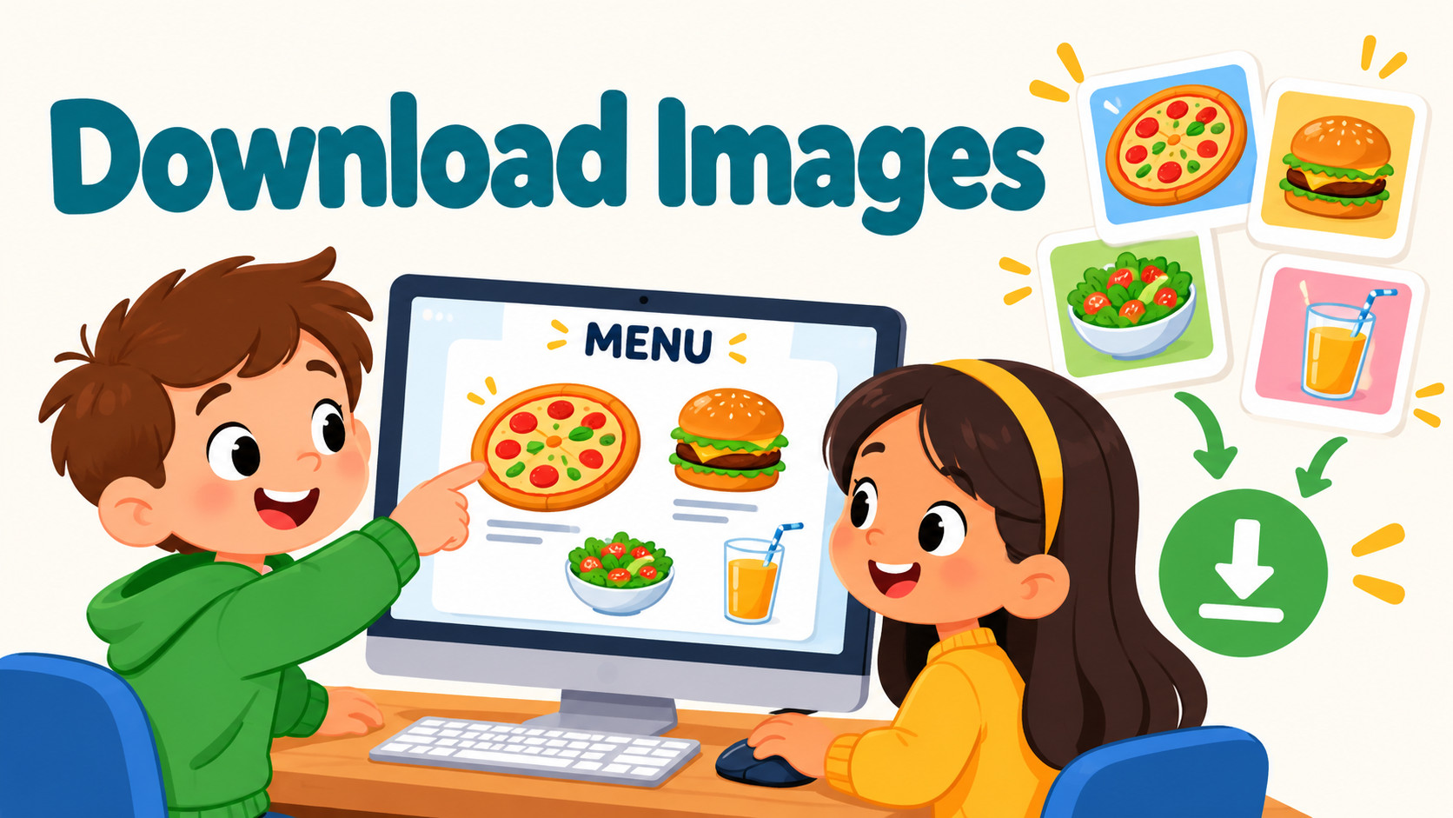
Notes:
Source: Oxford International Primary Computing Student Book 2, Unit 2 Digital literacy: The secret restaurant, section 2.3 Download images, printed pages 26–27, and section 2.4 Choose websites, pages 28–29. Classroom adaptation. Permission must be checked; adding free to a search alone does not establish reuse permission. Advertisements identified by labels, rather than fixed screen position. Illustrations are generated teaching examples.

Slide 2
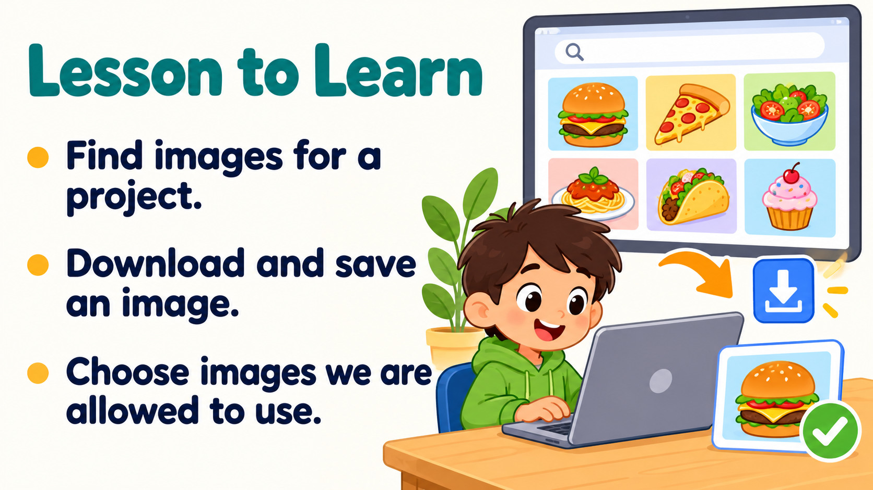
Notes:
Source: Oxford International Primary Computing Student Book 2, Unit 2 Digital literacy: The secret restaurant, section 2.3 Download images, printed pages 26–27, and section 2.4 Choose websites, pages 28–29. Classroom adaptation. Permission must be checked; adding free to a search alone does not establish reuse permission. Advertisements identified by labels, rather than fixed screen position. Illustrations are generated teaching examples.

Slide 3
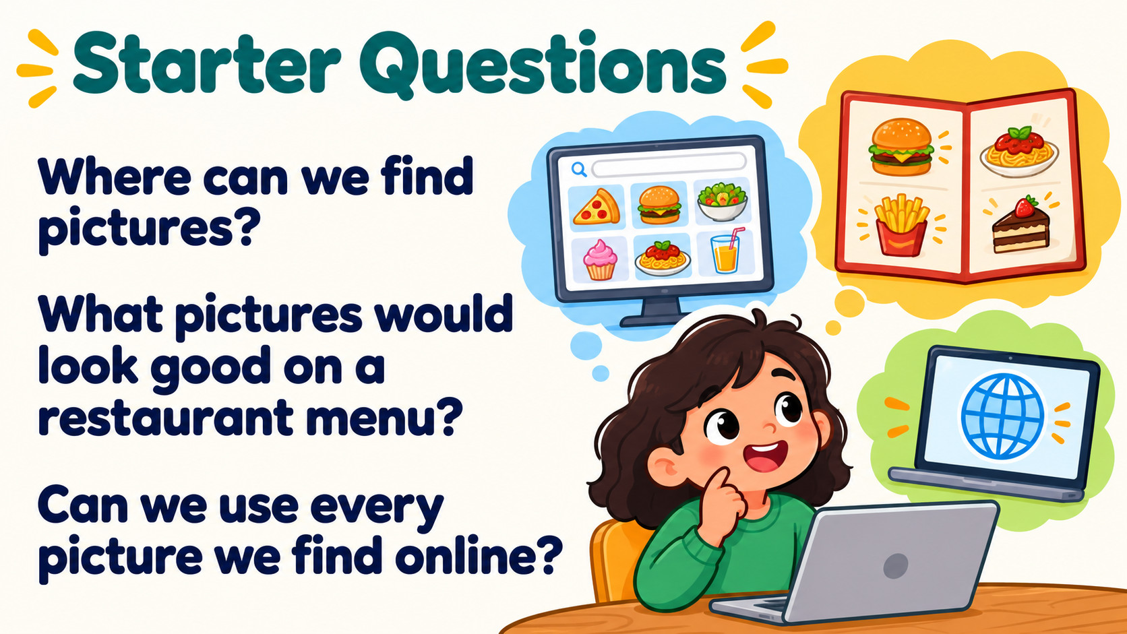
Notes:
Source: Oxford International Primary Computing Student Book 2, Unit 2 Digital literacy: The secret restaurant, section 2.3 Download images, printed pages 26–27, and section 2.4 Choose websites, pages 28–29. Classroom adaptation. Permission must be checked; adding free to a search alone does not establish reuse permission. Advertisements identified by labels, rather than fixed screen position. Illustrations are generated teaching examples.

Slide 4
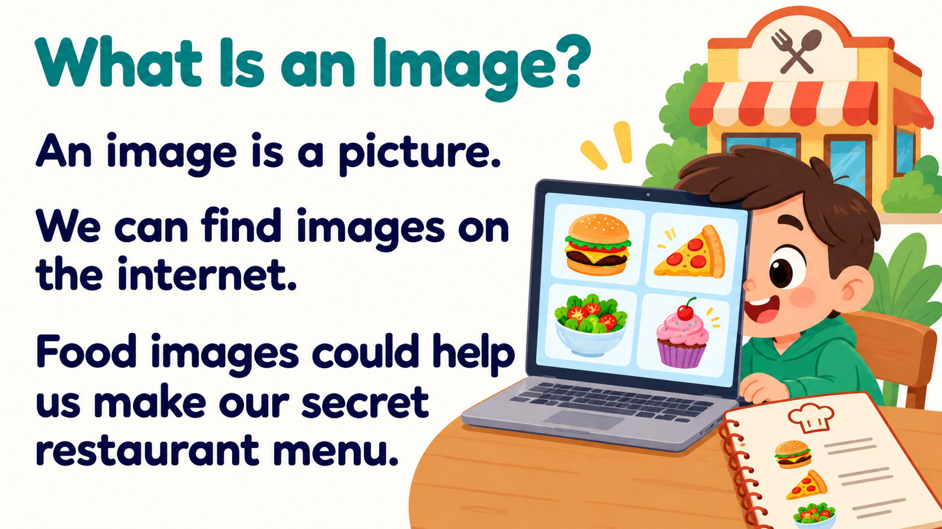
Notes:
Source: Oxford International Primary Computing Student Book 2, Unit 2 Digital literacy: The secret restaurant, section 2.3 Download images, printed pages 26–27, and section 2.4 Choose websites, pages 28–29. Classroom adaptation. Permission must be checked; adding free to a search alone does not establish reuse permission. Advertisements identified by labels, rather than fixed screen position. Illustrations are generated teaching examples.

Slide 5
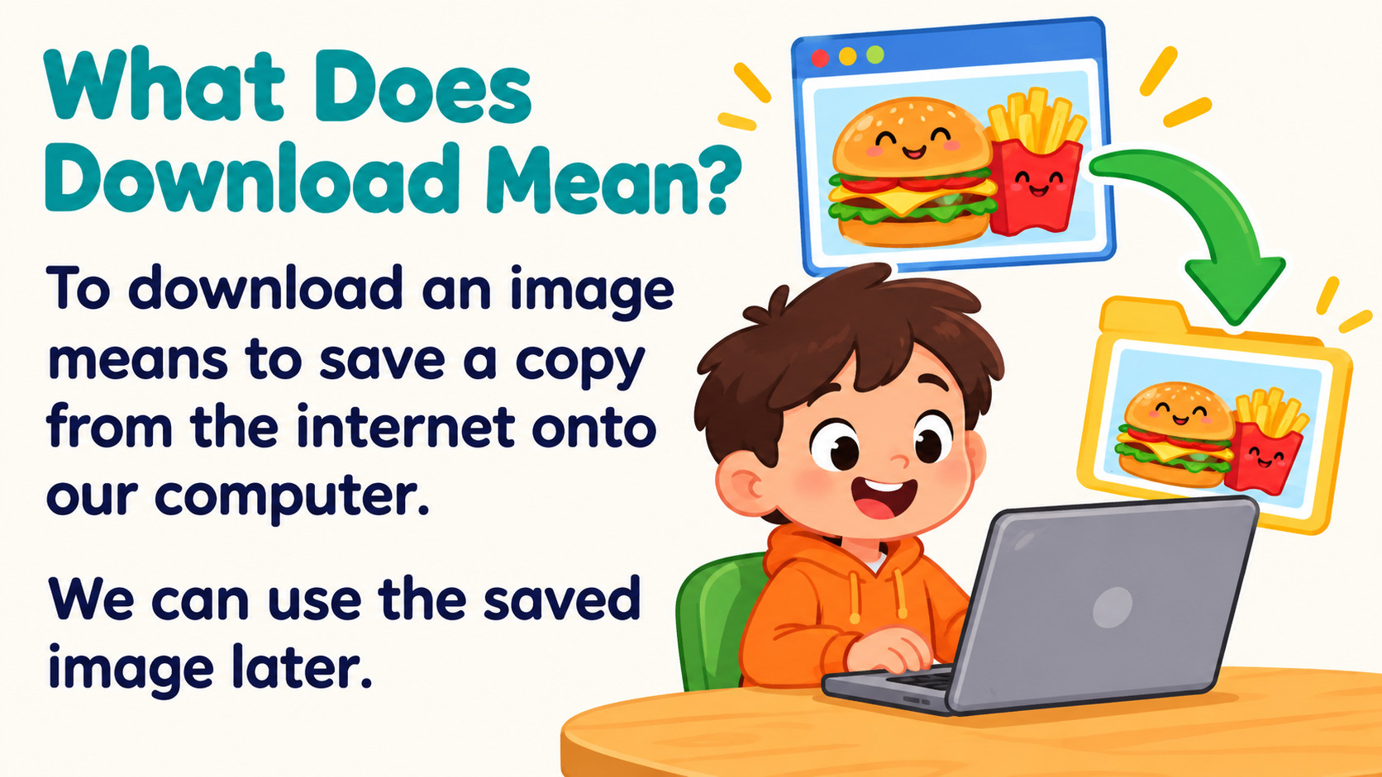
Notes:
Source: Oxford International Primary Computing Student Book 2, Unit 2 Digital literacy: The secret restaurant, section 2.3 Download images, printed pages 26–27, and section 2.4 Choose websites, pages 28–29. Classroom adaptation. Permission must be checked; adding free to a search alone does not establish reuse permission. Advertisements identified by labels, rather than fixed screen position. Illustrations are generated teaching examples.

Slide 6
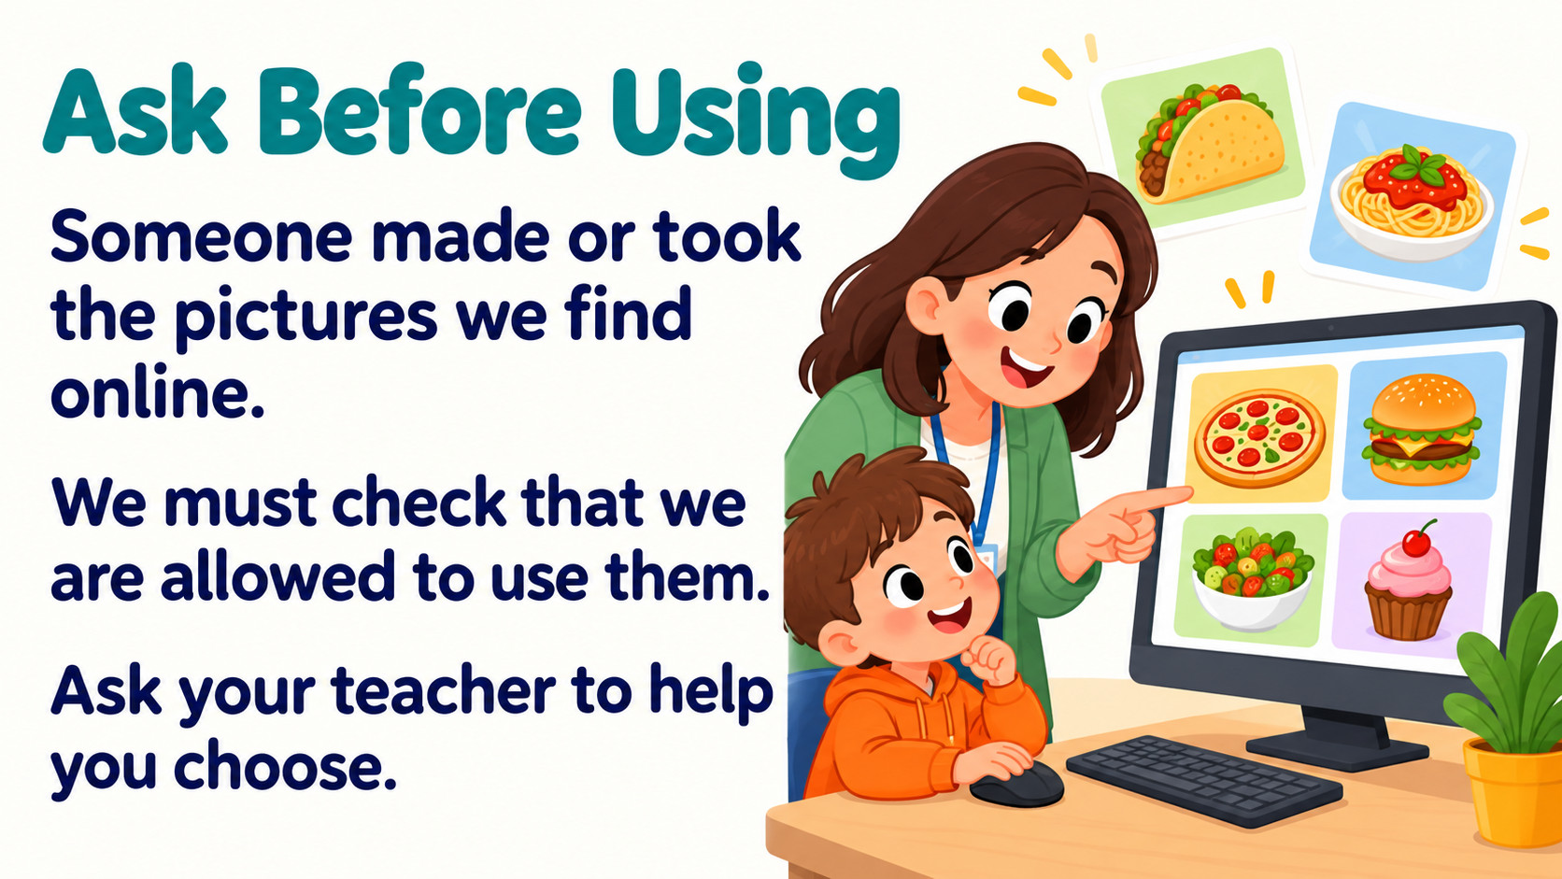
Notes:
Source: Oxford International Primary Computing Student Book 2, Unit 2 Digital literacy: The secret restaurant, section 2.3 Download images, printed pages 26–27, and section 2.4 Choose websites, pages 28–29. Classroom adaptation. Permission must be checked; adding free to a search alone does not establish reuse permission. Advertisements identified by labels, rather than fixed screen position. Illustrations are generated teaching examples.

Slide 7
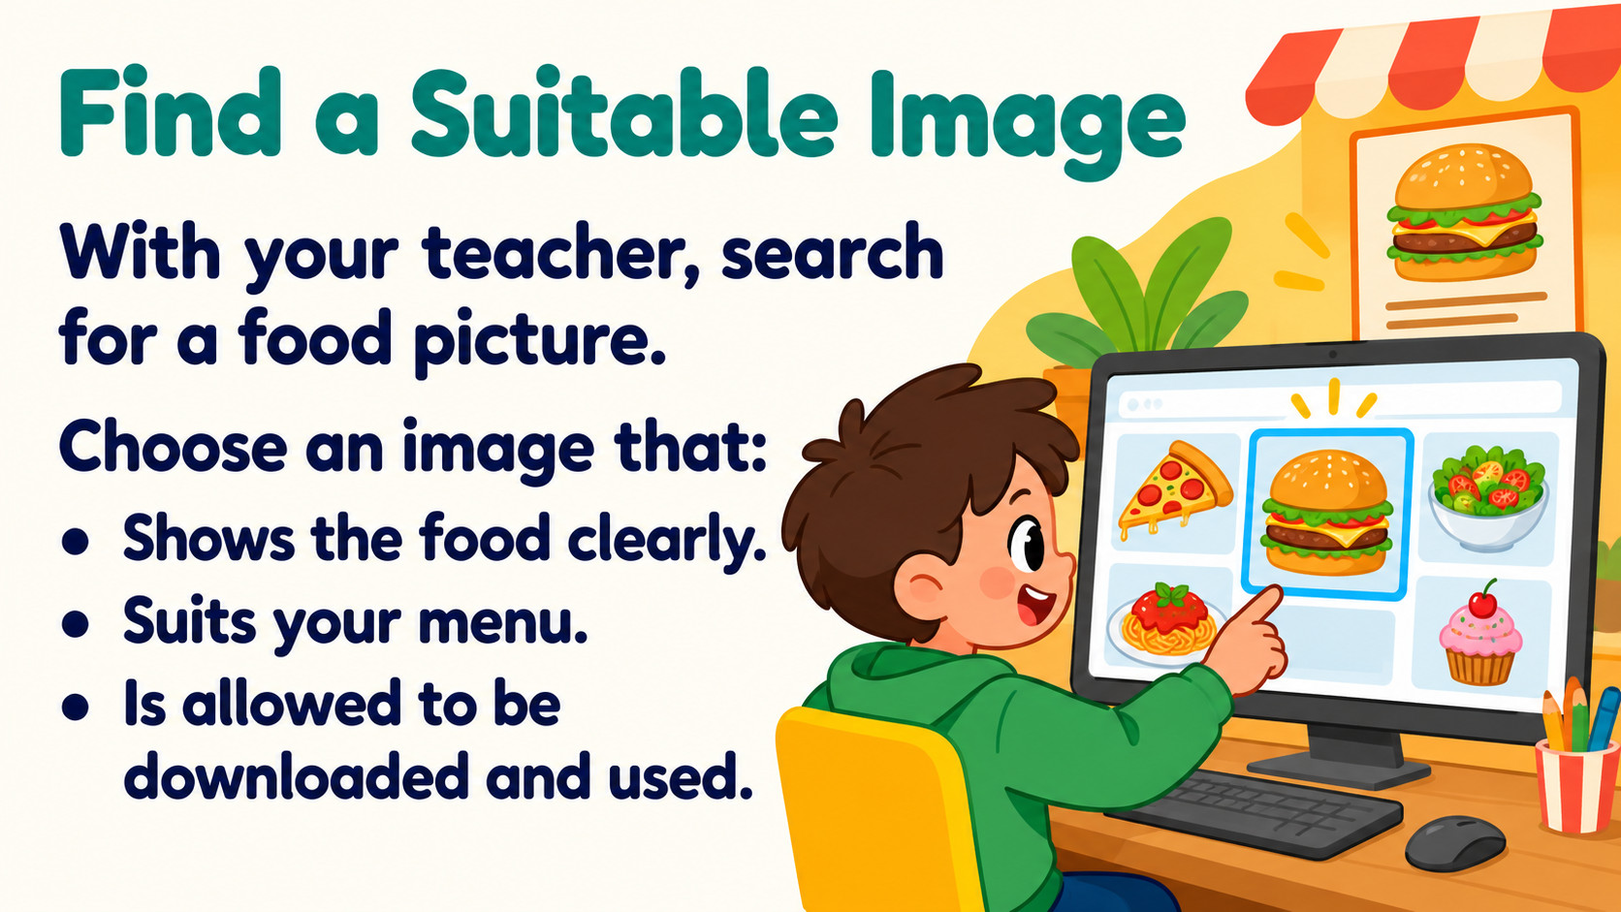
Notes:
Source: Oxford International Primary Computing Student Book 2, Unit 2 Digital literacy: The secret restaurant, section 2.3 Download images, printed pages 26–27, and section 2.4 Choose websites, pages 28–29. Classroom adaptation. Permission must be checked; adding free to a search alone does not establish reuse permission. Advertisements identified by labels, rather than fixed screen position. Illustrations are generated teaching examples.

Slide 8
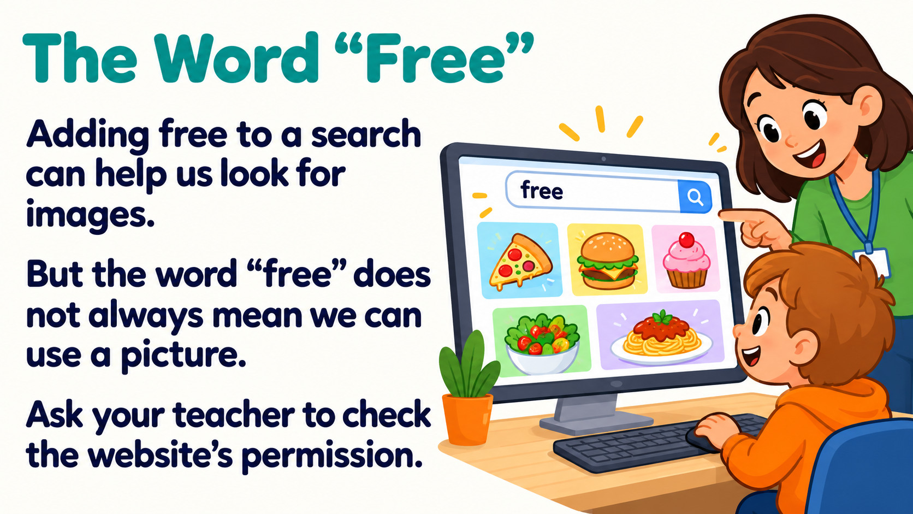
Notes:
Source: Oxford International Primary Computing Student Book 2, Unit 2 Digital literacy: The secret restaurant, section 2.3 Download images, printed pages 26–27, and section 2.4 Choose websites, pages 28–29. Classroom adaptation. Permission must be checked; adding free to a search alone does not establish reuse permission. Advertisements identified by labels, rather than fixed screen position. Illustrations are generated teaching examples.

Slide 9
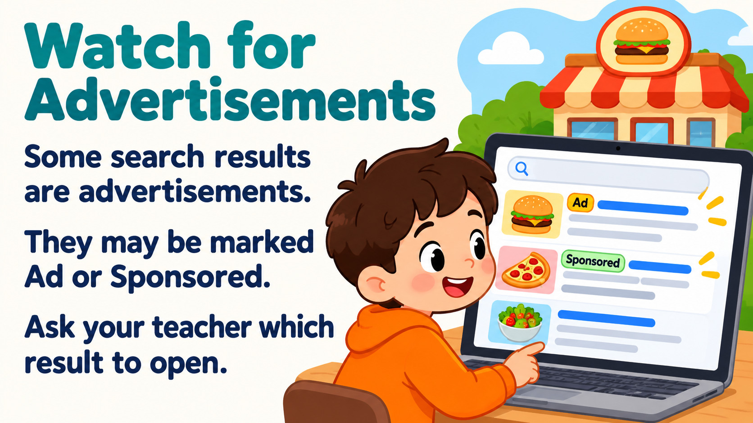
Notes:
Source: Oxford International Primary Computing Student Book 2, Unit 2 Digital literacy: The secret restaurant, section 2.3 Download images, printed pages 26–27, and section 2.4 Choose websites, pages 28–29. Classroom adaptation. Permission must be checked; adding free to a search alone does not establish reuse permission. Advertisements identified by labels, rather than fixed screen position. Illustrations are generated teaching examples.

Slide 10
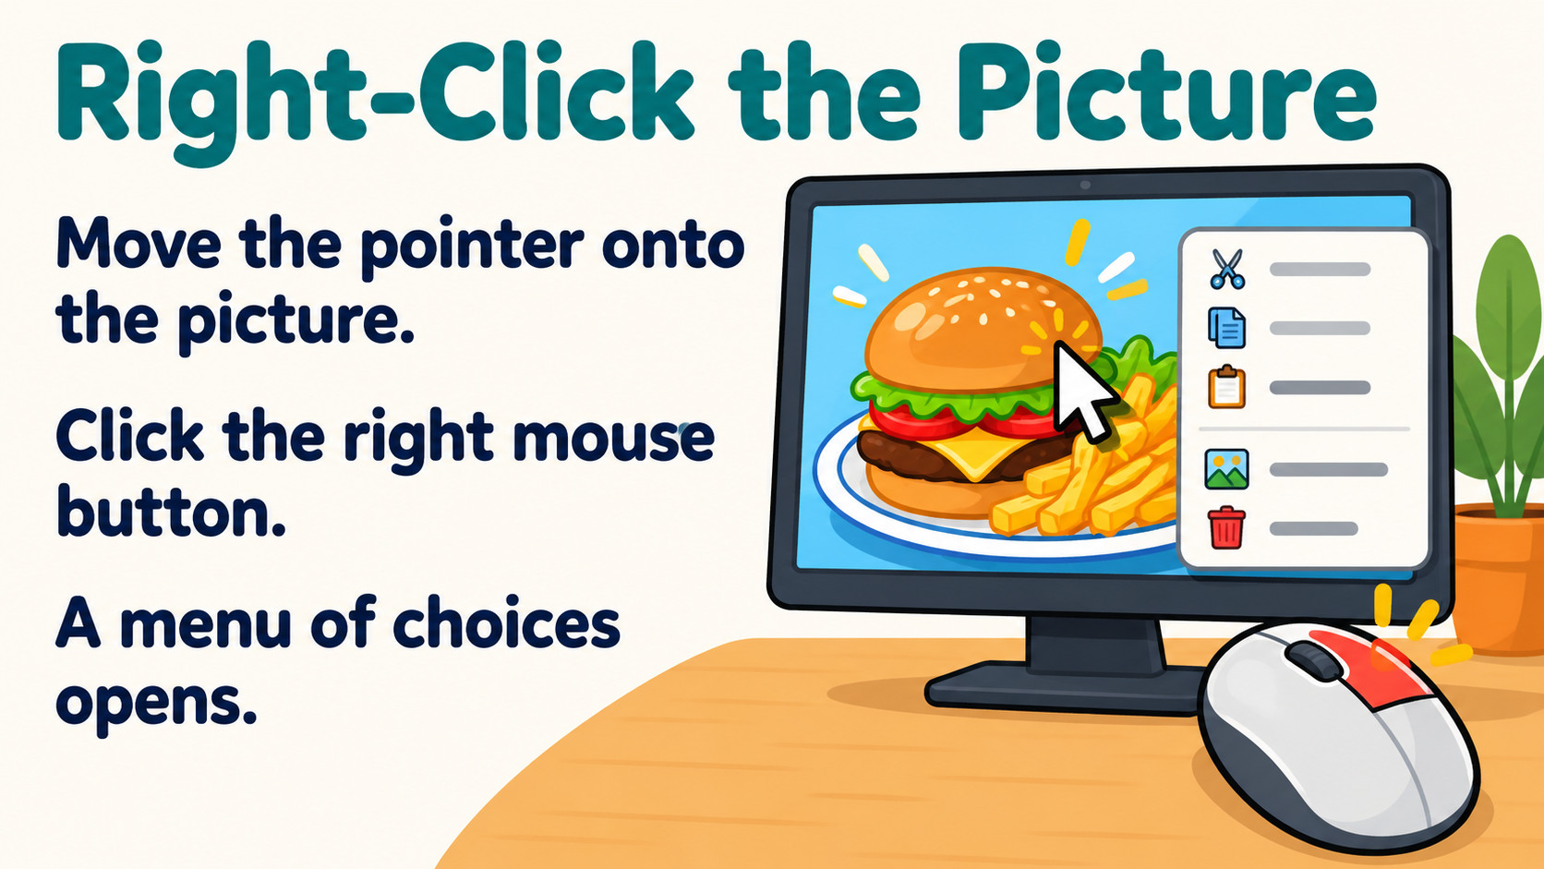
Notes:
Source: Oxford International Primary Computing Student Book 2, Unit 2 Digital literacy: The secret restaurant, section 2.3 Download images, printed pages 26–27, and section 2.4 Choose websites, pages 28–29. Classroom adaptation. Permission must be checked; adding free to a search alone does not establish reuse permission. Advertisements identified by labels, rather than fixed screen position. Illustrations are generated teaching examples.

Slide 11
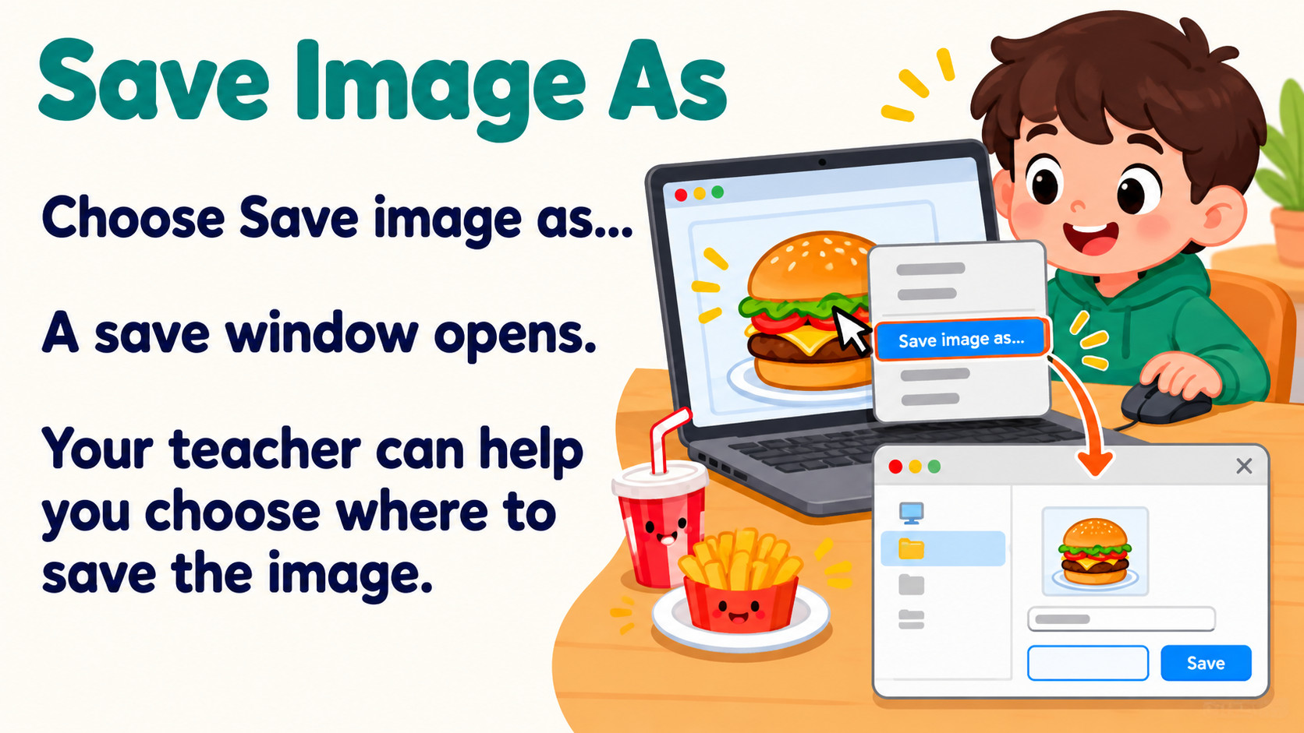
Notes:
Source: Oxford International Primary Computing Student Book 2, Unit 2 Digital literacy: The secret restaurant, section 2.3 Download images, printed pages 26–27, and section 2.4 Choose websites, pages 28–29. Classroom adaptation. Permission must be checked; adding free to a search alone does not establish reuse permission. Advertisements identified by labels, rather than fixed screen position. Illustrations are generated teaching examples.

Slide 12
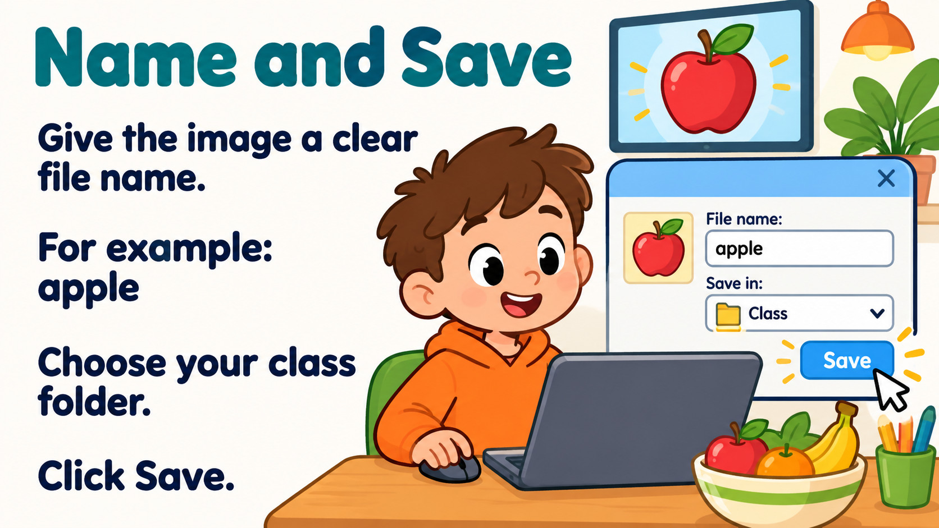
Notes:
Source: Oxford International Primary Computing Student Book 2, Unit 2 Digital literacy: The secret restaurant, section 2.3 Download images, printed pages 26–27, and section 2.4 Choose websites, pages 28–29. Classroom adaptation. Permission must be checked; adding free to a search alone does not establish reuse permission. Advertisements identified by labels, rather than fixed screen position. Illustrations are generated teaching examples.

Slide 13
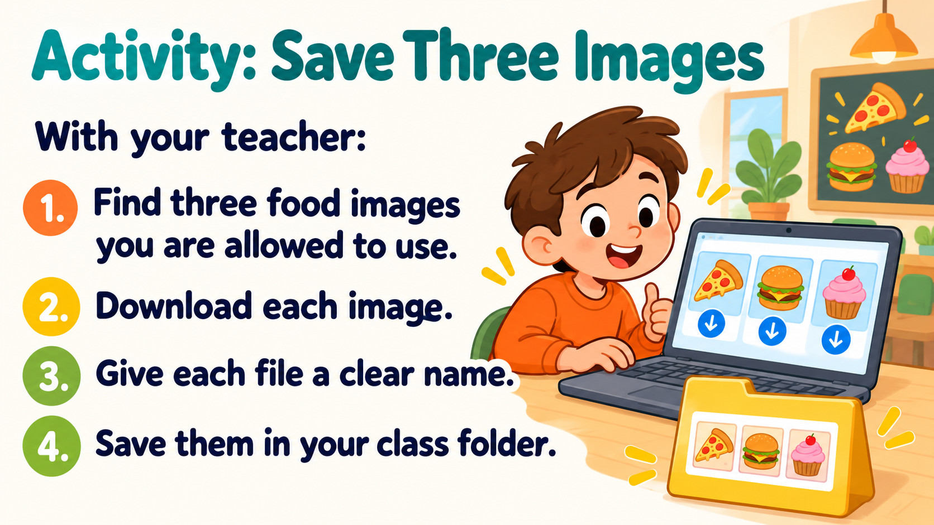
Notes:
Source: Oxford International Primary Computing Student Book 2, Unit 2 Digital literacy: The secret restaurant, section 2.3 Download images, printed pages 26–27, and section 2.4 Choose websites, pages 28–29. Classroom adaptation. Permission must be checked; adding free to a search alone does not establish reuse permission. Advertisements identified by labels, rather than fixed screen position. Illustrations are generated teaching examples.

Slide 14
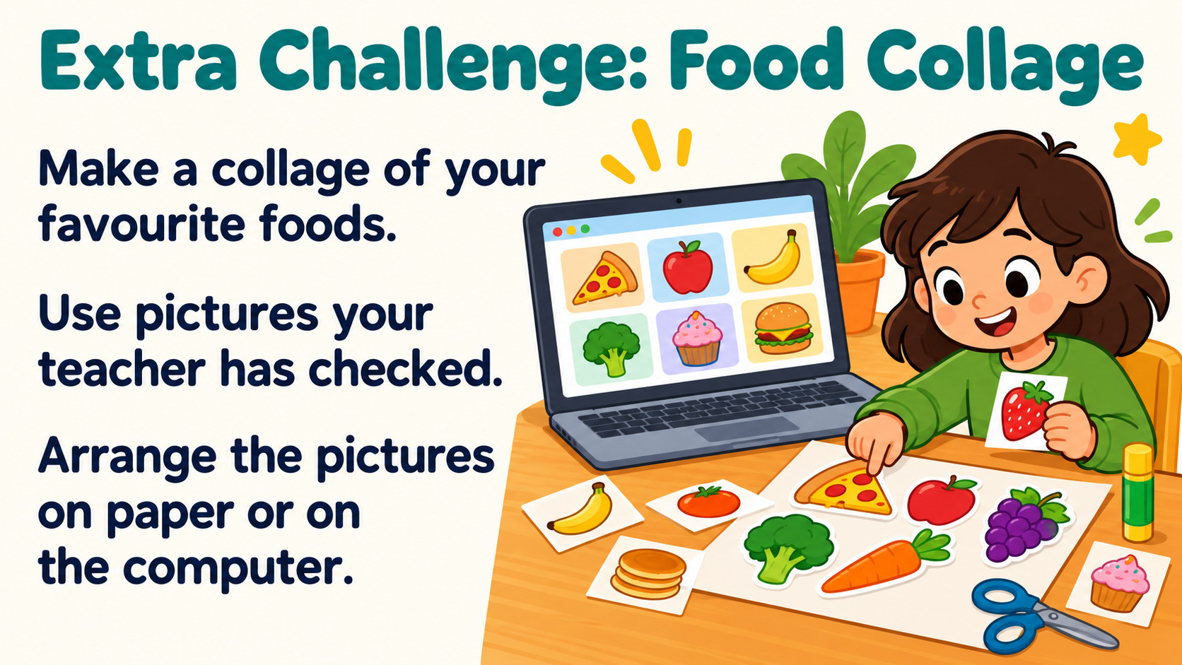
Notes:
Source: Oxford International Primary Computing Student Book 2, Unit 2 Digital literacy: The secret restaurant, section 2.3 Download images, printed pages 26–27, and section 2.4 Choose websites, pages 28–29. Classroom adaptation. Permission must be checked; adding free to a search alone does not establish reuse permission. Advertisements identified by labels, rather than fixed screen position. Illustrations are generated teaching examples.

Slide 15
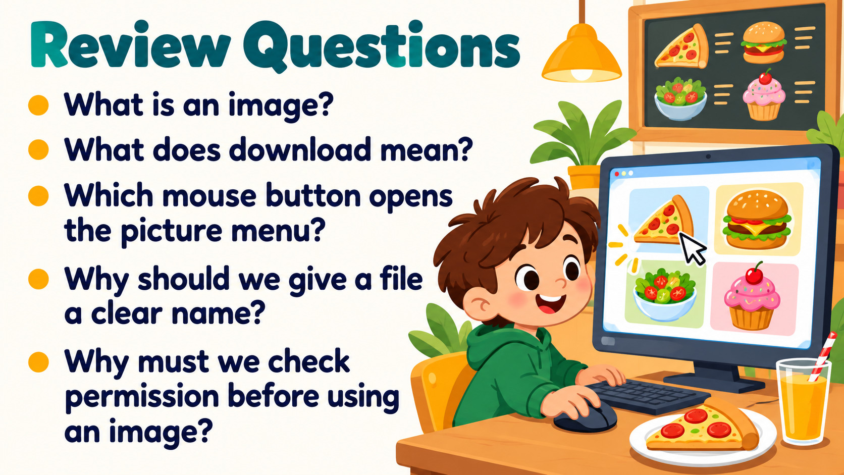
Notes:
Source: Oxford International Primary Computing Student Book 2, Unit 2 Digital literacy: The secret restaurant, section 2.3 Download images, printed pages 26–27, and section 2.4 Choose websites, pages 28–29. Classroom adaptation. Permission must be checked; adding free to a search alone does not establish reuse permission. Advertisements identified by labels, rather than fixed screen position. Illustrations are generated teaching examples.

